Slide 1
Filtering, Sorting, and Other Processing Techniques
February 15, 2018
Presenter :

Slide 2
Filtering, Sorting, and Other Processing Techniques
Filtering data (tFilerRows and tFilterColumns)
Filter and split.(tSplitRows)
Sorting data.(tSortRow)
Aggregating data (tAggregateRow)
Understanding Data normalization (tNormalize)
Understanding Data demoralization tDenormalize)
Extracting delimited fields (tExtractDelimitedFields)
Extracting Sample rows (tSampleRows).

Slide 3
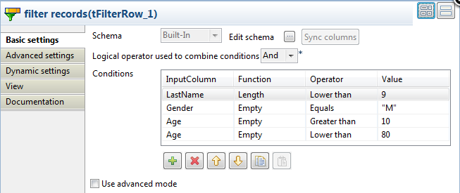
Filtering data – tFilterRow
tFilterRow filters input rows by setting one or more conditions on the selected columns.

Slide 4
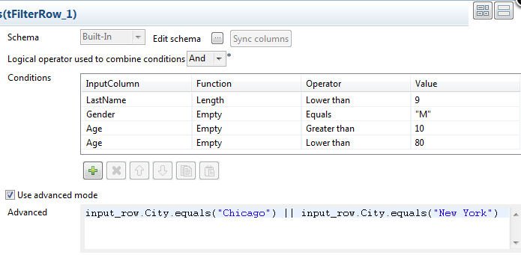
Filtering data – tFilterRow

Slide 5

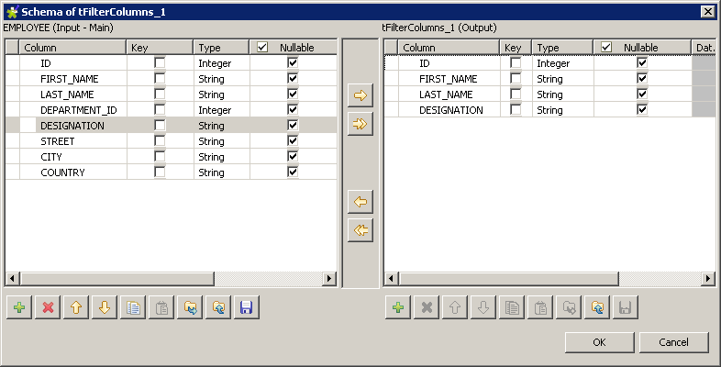
Filtering data – tFilterColumns
Makes specified changes to the schema defined, based on column name
mapping.

Slide 6
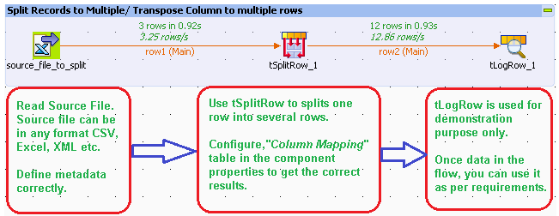
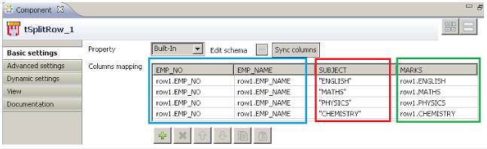
Splitting Data - tSplitRow
This component helps splitting one input row into several output rows.

Slide 7

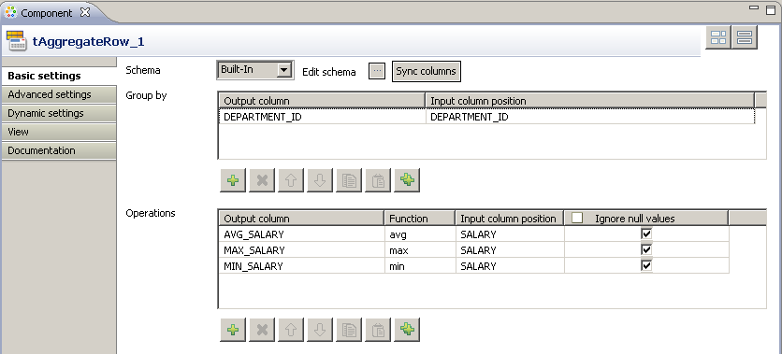
Aggregating data - tAggregateRow
tAggregateRow receives a flow and aggregates it based on one or more columns.

Slide 8
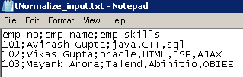

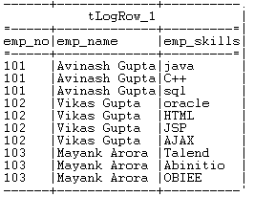
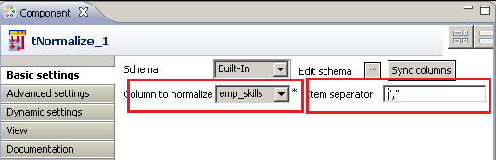
Data normalization (tNormalize)
It Normalize the data by converting a single row to multiple rows.

Slide 9
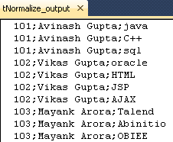

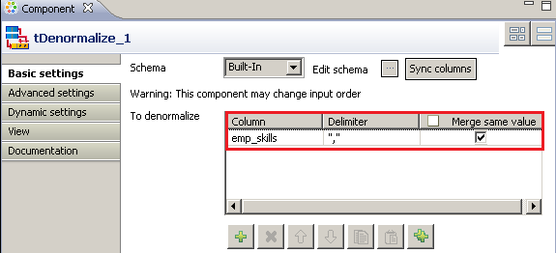
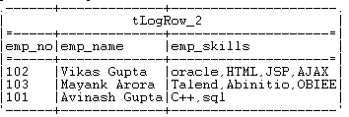
Data Denormalization (tDeNormalize)
It helps to group the data into single record based on the defined key.

Slide 10
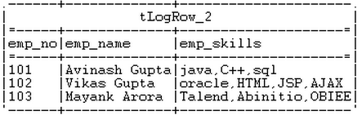
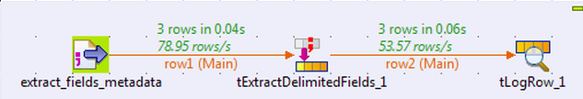
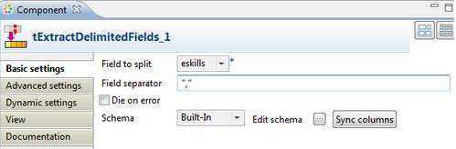
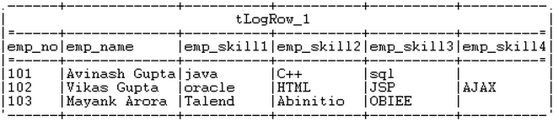
Extracting delimited fields (tExtractDelimitedFields)
Converts single column into multiple columns in Talend

Slide 11

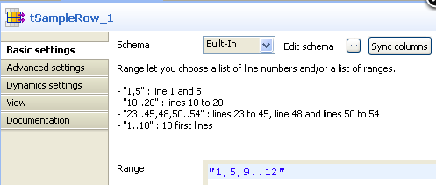
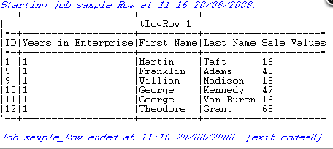
Extracting Sample rows (tSampleRow)
tSampleRow filters rows according to line numbers.

Slide 12
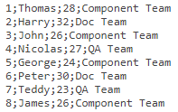
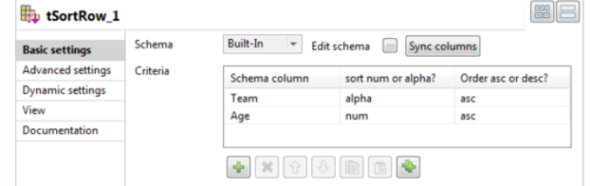
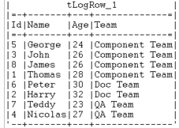
tSortRow
Its help the data to sort in asc or desc order.

Slide 13
tExternalSortRow
Uses an external sort application to sort input data based on one or several columns, by sort type and order

Slide 14
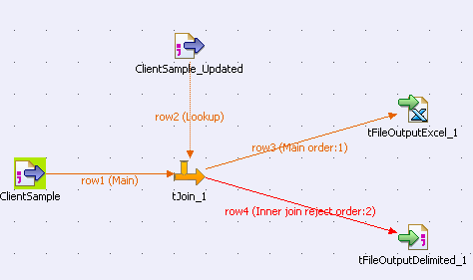
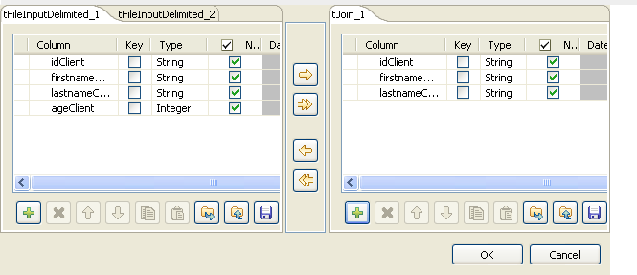
tJoin
tJoin joins two tables by doing an exact match on several columns. It compares columns from the main flow with reference columns from the lookup flow and outputs the main flow data and/or the rejected data.
Copyright © 2014 by Vikram Takkar. All Rights Reserved..

Slide 15
Questions?
Copyright © 2014 by Vikram Takkar. All Rights Reserved..

